Slide 1
COMP 8715
The Cinema Project
Yixian Qiu u6935151
Jiawei Fan u5922620
Yuliang Ma u6462980
Tao Qu u6965457
Xiaoxiang Kong u6828507
Yuchen Wang u6928271
Jiaye Li u7052525

Slide 2
Table of Contents
01
Introduction
06
05
Decision Making
02
Technical Overview
Teamwork
03
07
Output
Reflection
04
08
Checklist
Future Scope

Slide 3
01
Introduction
By Yuliang Ma

Slide 4

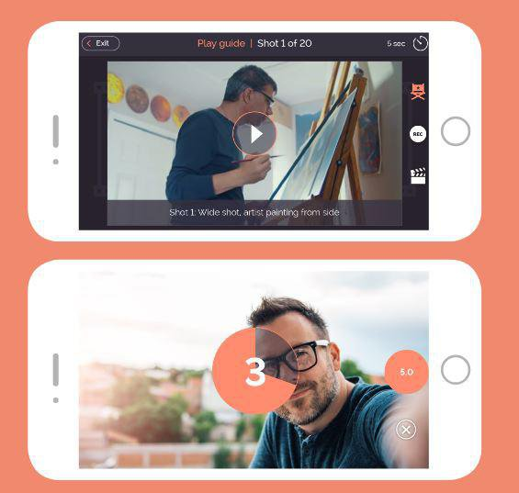

Our Project
Our client Cinefly is a story telling platform.
Our client wants to know about the user.
Our project team aims to help Cinefly to extract those information.

Slide 5
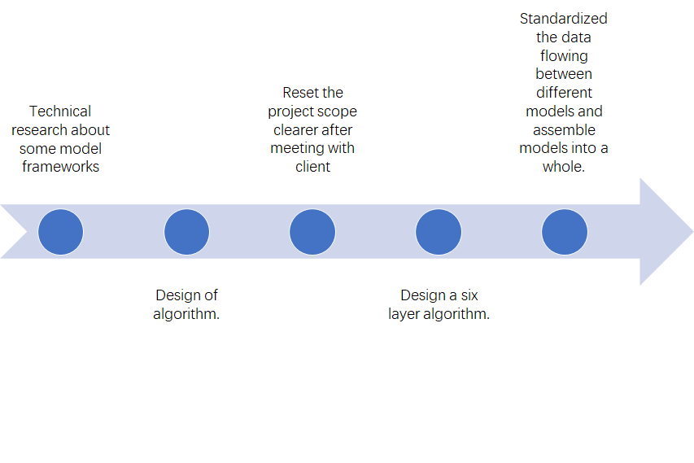
1.1 Timeline(Last Semester)

Slide 6
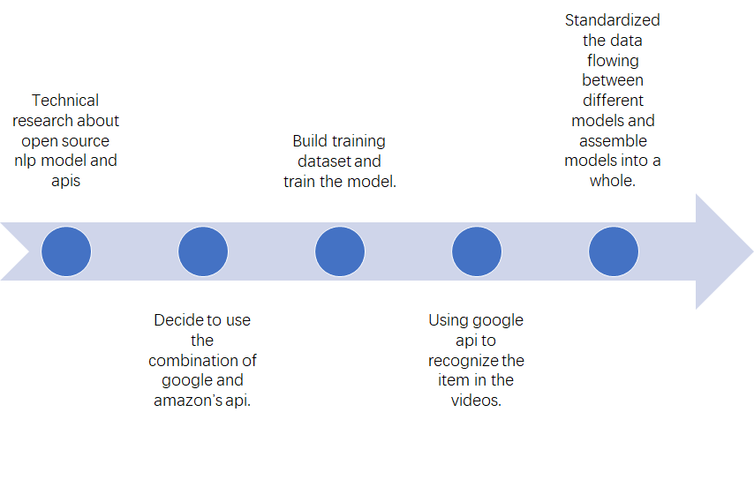
1.1 Timeline(This Semester)

Slide 7
02
Technical Overview
By Yuliang Ma

Slide 8
2.1 Project Goal: Information Extraction
Input
Source Video
S1, CV
S2, NLP
Technical Routs
Visual Info
Audio Info
Target Labels
Age
Gender
Activity
Name
Diet
Interest
Integrated File Output

Slide 9
2.1 Project Goal: Information Extraction
Visual Info
Technology
Computer Vision
Models
CaffeNet
MediaPipe
Scikit-learn
Open-CV
...
Age
Gender
Activity
Technology
Natural language processing
Models
MediaPy
Google Speech to Text
Amazon Comprehend
Google Vision
...
Audio Info
Name
Diet
Interest

Slide 10
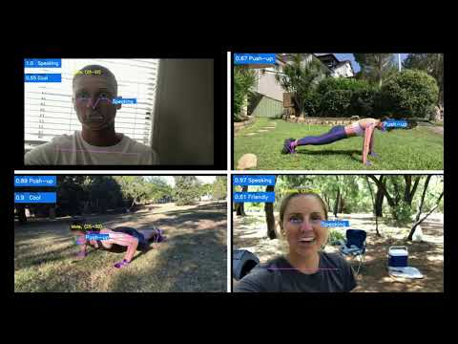
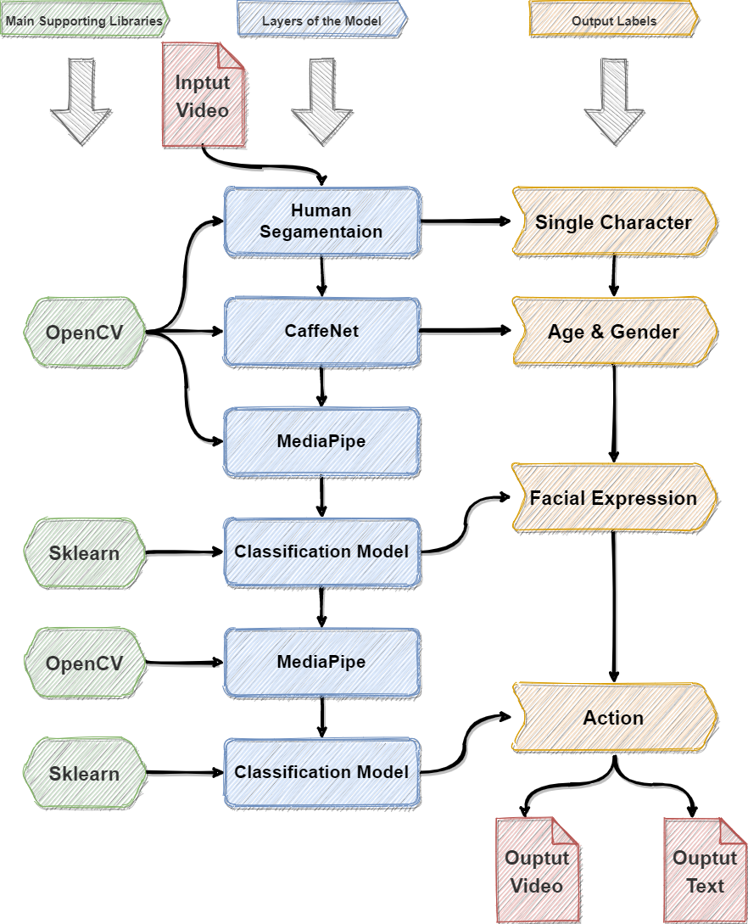
2.2 Phase 1: Computer Vision 2021.2-2021.6
Visual Info
Age
Gender
Activity

Slide 11
2.3 Phase 2: NLP + Integration 2021.7-2021.11
Challenge
Input Source
Raw videos from the users
MediaPy
Audio of the users' voice
Google Speech to Text
Script text of what the user said
Amazon Comprehend
Target entities eg: [Name: Amy], [Occupation: personal trainner], [Food: apple], etc.
Model Integration
One file that integrates all outputs of the two phases.
One User
...
Video File 1
Video File 2
Video File 8
Audio Info
Name
Diet
Interest
Challenge

Slide 12
03
Output
By Yixian Qiu

Slide 13
3.1 Demo
Earlier
DEMO 1
DEMO 2
Exploration
DEMO 4 (FAILURE)
Now
DEMO 5
DEMO 3

Slide 14
3.2 Test
Program stability
Output stability
Accuracy stability
Programs

Slide 15
3.3 Output from program
Computer vision
People expression, age, gender, emotion
Goods in scene
Natural language processing
Speech Content
Data frame
Labels

Slide 16
3.4 What other things in repository
Necessary keys for API
User manual
Signed checklist
Output example
Pre-trained model

Slide 17
04
Checklist
By Yixian Qiu

Slide 18
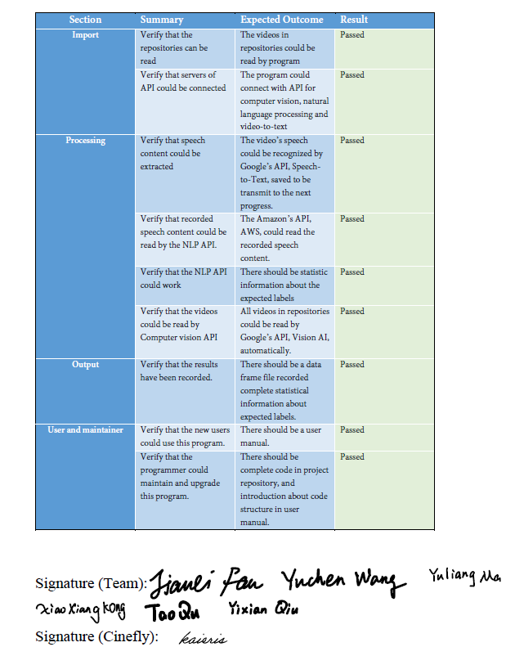
4.1 Checklist
Import
Processing
Output
User and maintainer

Slide 19
4.2 Usage to the client
Deliver user image
Show the needs of the group
Commercial value

Slide 20
05
Decision Making
By Xiaoxiang Kong

Slide 21







Standard process of making decisions
>Discuss it & Research it
>Execute it
>Publish it
>Record & Summarize it
Scheme
>Report it
>Just do it!
Project spokesman or manager

Slide 22
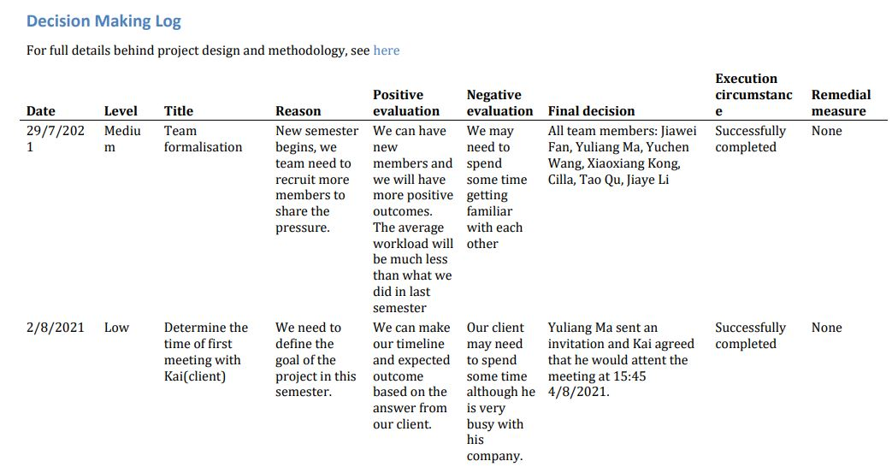
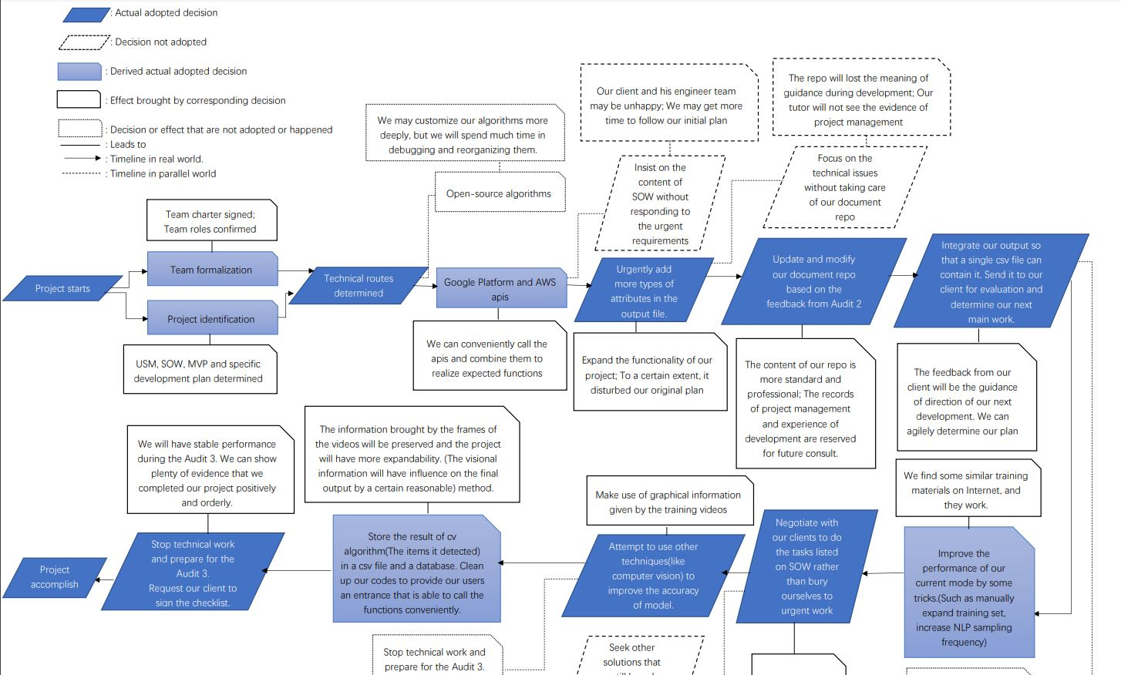
View of various Decision_logs
Pdf file
Cladogram
Detailed
Explicit
Time sequence
Easy to discover relationships

Slide 23
06
Teamwork
By Tao Qu

Slide 24
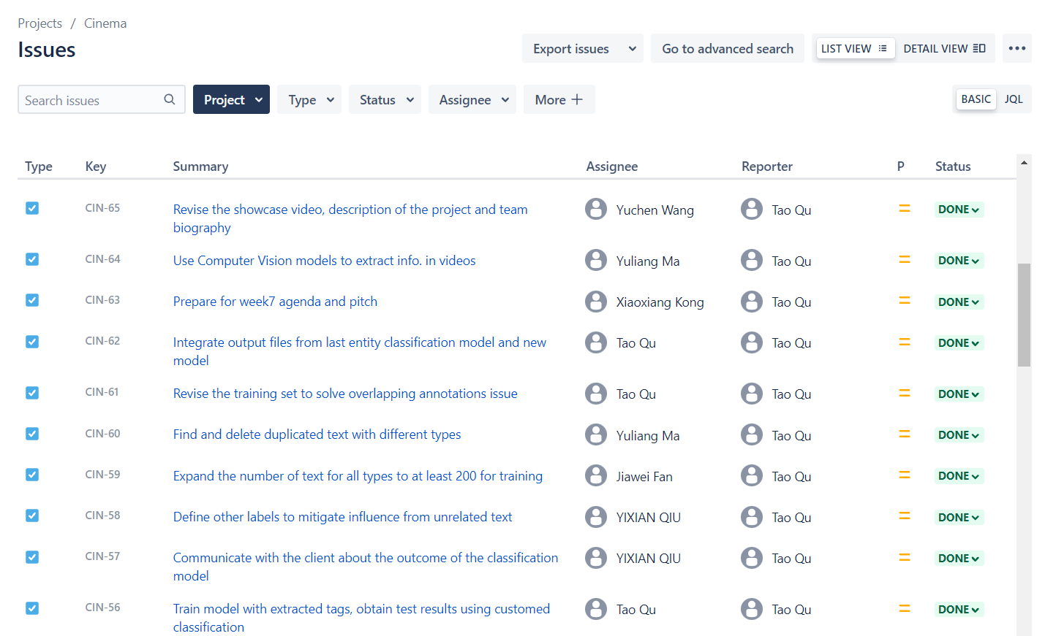
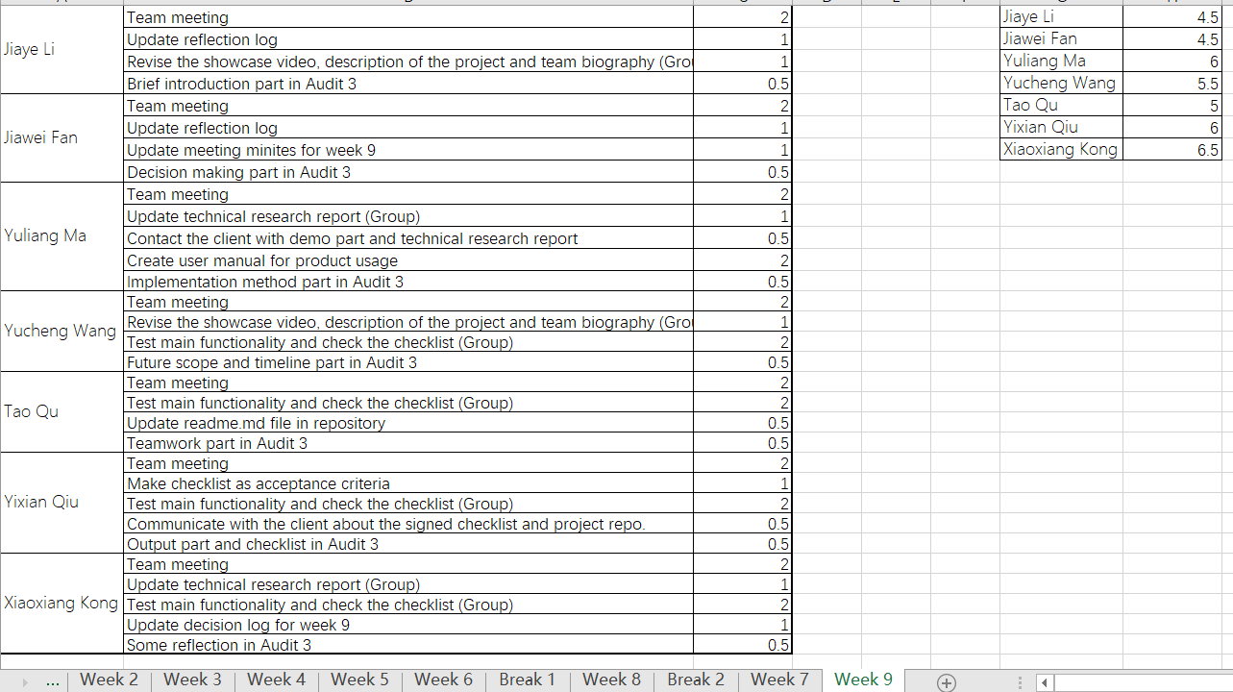
Task Management
Jira Task Panel
Working Time Log

Slide 25

Team Collaboration
Individual Work
Retrieved from https://www.flexjobs.com/employer-blog/hybrid-workplace-for-companies/

Slide 26

Team Collaboration
Group Work
Retrieved from https://www.flexjobs.com/employer-blog/stay-connected-team-working-from-home-remotely/

Slide 27
07
Reflection
By Jiawei Fan

Slide 28




Communication
Stakeholders
The team

Slide 29
What is good communication?
Stakeholders
1. Clarification
2. Negotiation
The team

Slide 30

Clarification
1. Can you do this task and then do that task?
2. Ok, but we've got a project plan
Client representative
The team
3. Oh! You are not doing an internship?
4. Yeah, we are doing a project!

Slide 31
Negotiation
1. Please do this
2. It is too much workload
Stakeholders
The team
4. Good Idea!
3. Maybe we can change the plan

Slide 32
08
Future Scope
By Jiaye Li

Slide 33

Database System
We plan to build a database system that store information extracted from user videos.

Slide 34
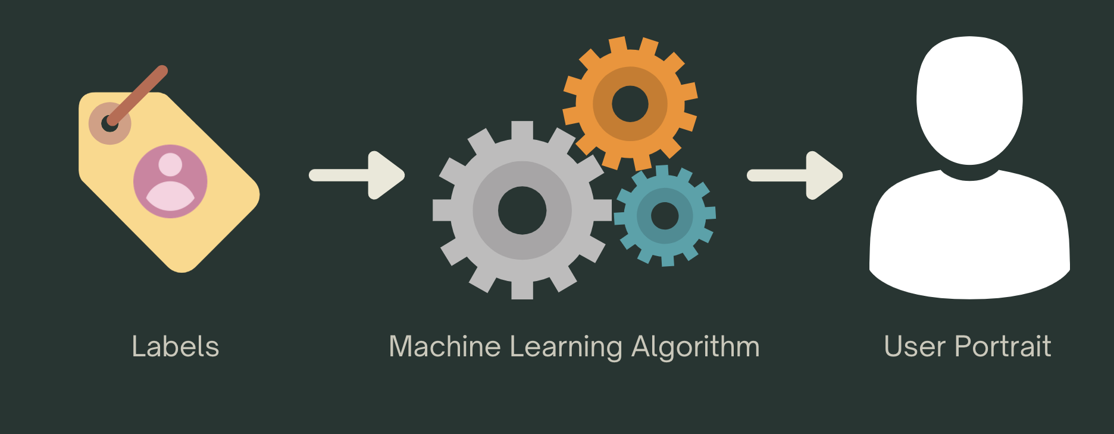
Machine Learning Recommendation Algorithm
We can build user profiles by establishing machine learning models and analyse user preferences to recommend corresponding contents

Slide 35
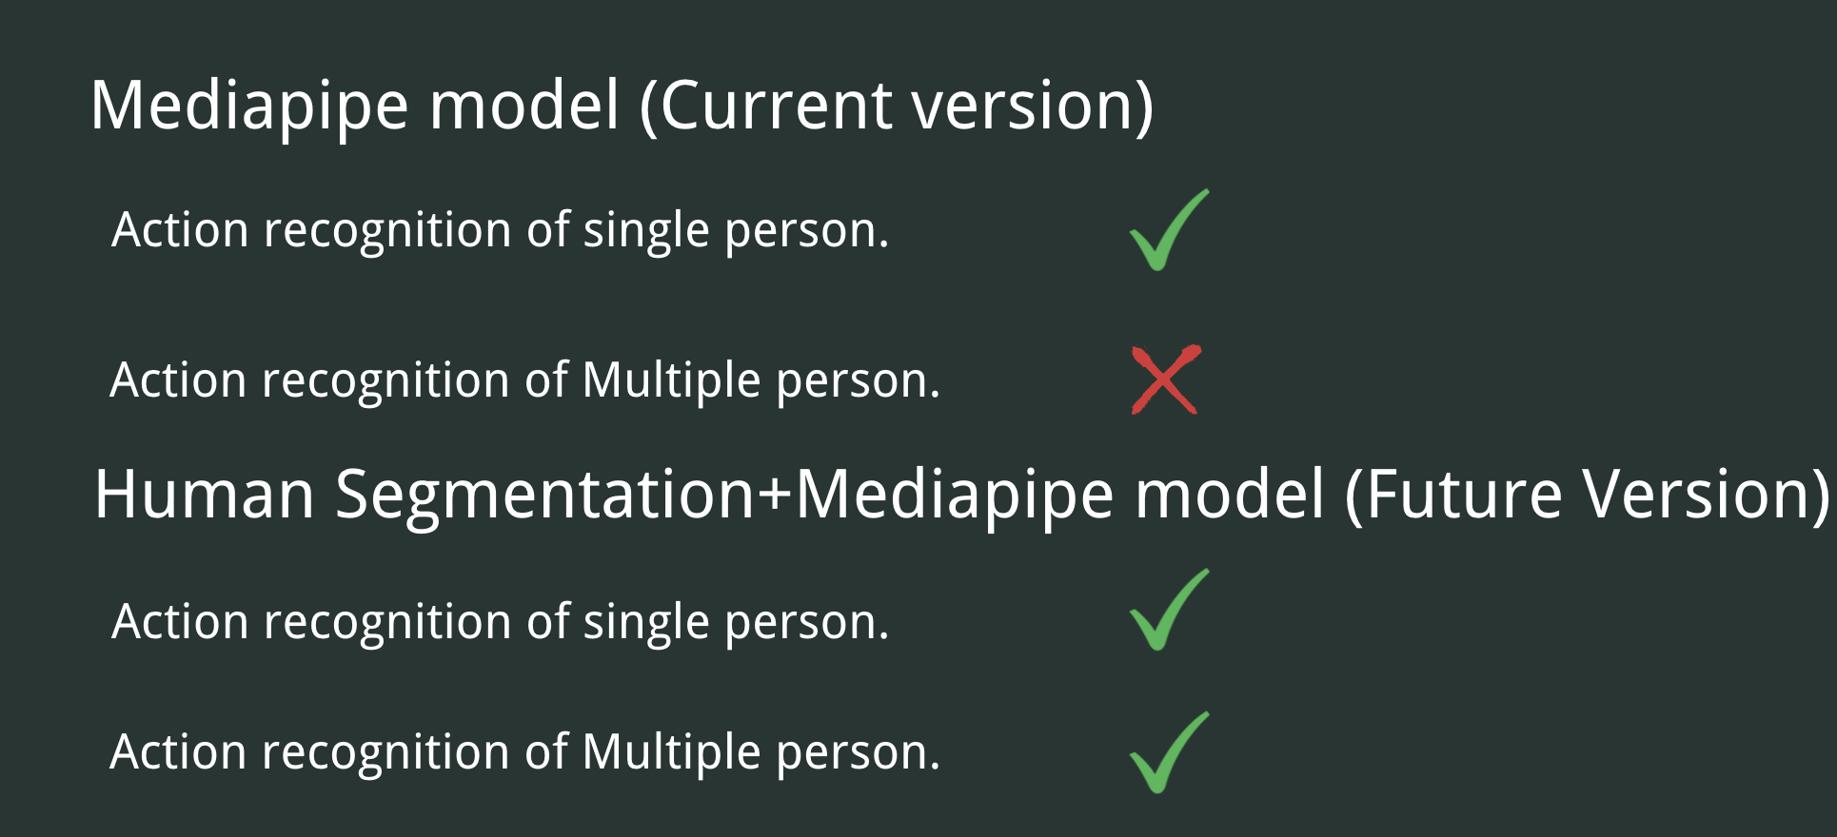
Improve action recognition algorithm
We plan to use human segmentation algorithm before running the media pipe to solve this problem.

Slide 36
Thanks for Watching!
Please feel free to ask questions!

